Slide 1
CHAPTER 1 : INTRODUCTIONS TO SYSTEM DESTRIBUTION
SYSTEMS INTEGRATION
Assoc.Prof. JAMES RWIGEMA

Slide 2
Functional Silos
Silos are basically compartmentalized operating units isolated from their environment.
Horizontal Silos
The POSDCORB (Planning, Organizing, Staffing, Directing, Coordinating, Reporting and Budgeting) categorization by Luther Gulick led to a set of formal organization functions such as control, management, supervision, and administration starting in late 1930s.
Classification of organizations into departments like Accounting and Human Resources, reflects the breaking of complex tasks into smaller manageable tasks that could be assigned to a group of people who could then be held responsible.

Slide 3
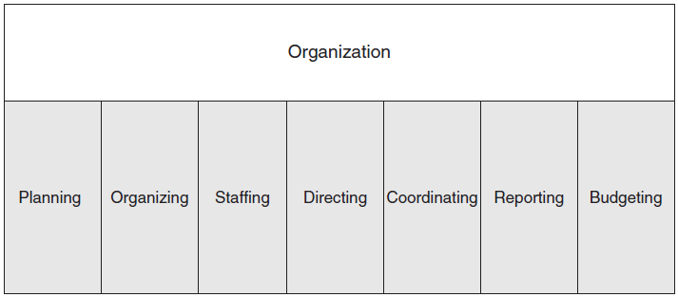
Figure 2-1 Functional Model of Organization (POSDCORB)

Slide 4
Functional Silos (Cont’d)
Vertical Silos
Organizations also divided roles in hierarchical layers from strategic planning to management control and operation control.
CEOs and Presidents plan long-term strategy, midlevel management focuses on tactical issues and on the execution of organizational policy whereas the lower-level management task is to focus on the day-to-day operations of the company.
As organizations get big and complex they tend to break functions into smaller units and assign staff the responsibility for these activities allowing them to manage complexity as well as specialize in activities that enhance productivity and efficiency.

Slide 5
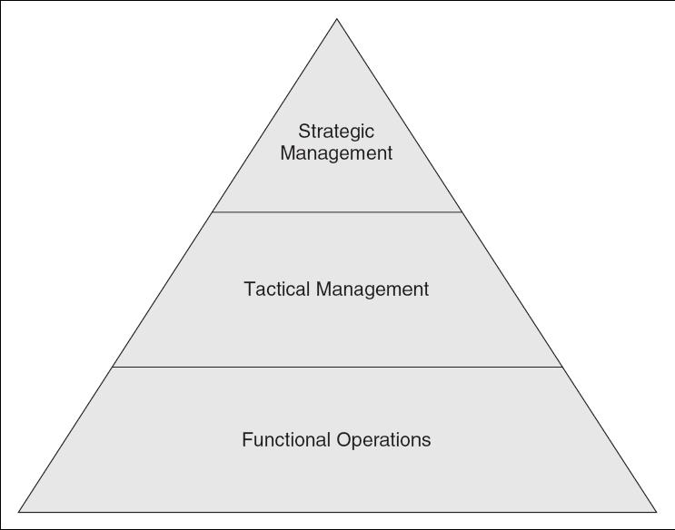
Figure 2-2 Hierarchical Model of Organization

Slide 6
Business Process and Silos
The problem of functional silos gave birth to business process re-engineering (BPR).
The cross-functional business process can involve people and resources from various functional departments working together, sharing information at any level of the organization.
The cross-functional organizational structure breaks the functional silos by opening up the informational flows from one department to another.

Slide 7
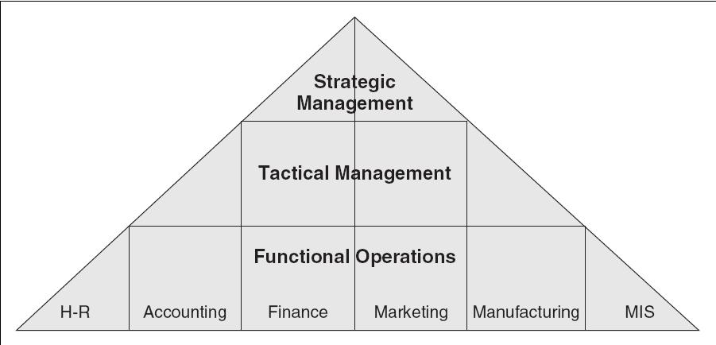
Figure 2-3 Matrix Structure of Organization

Slide 8
Evolution of Information Systems in Organizations
The functions of an organization (e.g., sales, manufacturing, and HR) are important as they provide a structure by which an organization functions smoothly.
A silo information system is inefficient, inaccurate, and expensive.
  The system creates bottlenecks for everyone and information is not available in real-time.
The evolution of IS suggests that its role has generally been to support evolving information needs of the organization.

Slide 9
IS Architectures
Rapid advances in computer and networking technologies and changing organizational dynamics, drive the emergence of new information system models.
Web-based systems today use a distributed architecture which allows the sharing of applications and data resources between the client and the server computers.
In this configuration, personal computers are connected via a network to a Web server that provides a window to an application and database server, which could be a mainframe or another type of computer.

Slide 10
IS Functionalization
In addition to serving the different management levels, IS also supports major business functions, such as manufacturing, marketing, accounting, finance, and HR.
Each functional area has different information needs and report requirements.
Each functional area in an organization also has multiple levels of management, each requiring different levels of analysis and details of information.

Slide 11
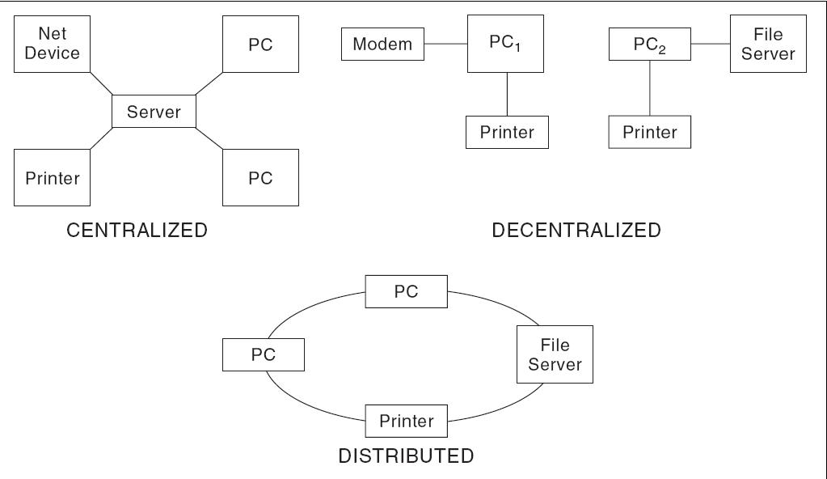
Figure 2-5 Destributed Systems Architectures

Slide 12
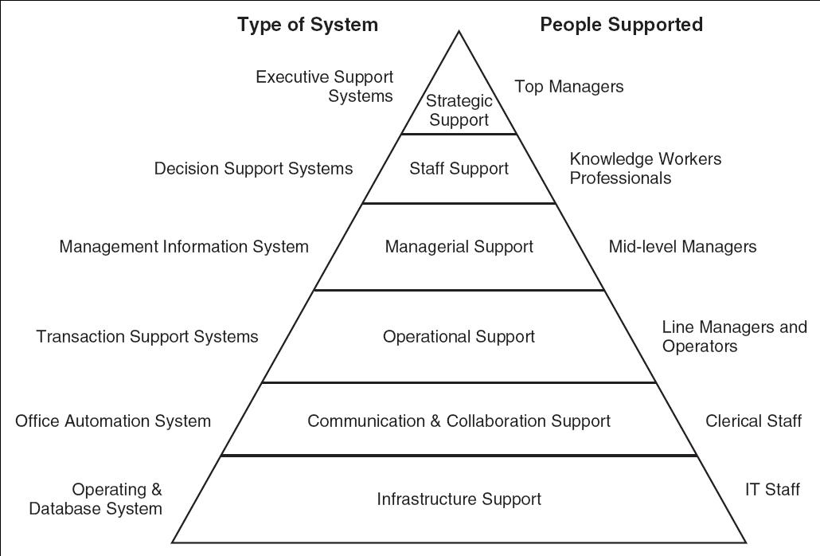
Figure 2-6 IS as Categorized by Functional and Hierarchical Models

Slide 13
Systems Integration
Logical
Develop information systems that allow organizations to share data with all of its stakeholders based on need and authorization.
Management needs to change organizational structures, processes, and employee roles and responsibilities.
Physical
Provide seamless connectivity between heterogeneous systems.
Business process reengineering involves changing the mindset of the employees in the organization, encouraging and enabling them to do their tasks in a new way.

Slide 14
Steps in Integrating Systems
Step 1 | Resource categorization | Instituting IT support for an integrated systems environment is necessary to avoid support and maintenance problems with the integrated system.
Step 2 | Compliance and standards | Develop a single sign-on policy because all employees and external partners will need access to an integrated system from anywhere, anytime.
Step 3 | Legacy systems support | Develop a policy in support of older legacy applications.
Step 4 | Middleware tools | Middleware tools are essential for integration in the short term if existing applications must be used by the organization.

Slide 15
Steps in Integrating Systems (Cont’d)
Step 5 | Authentication and authorization policies | Single sign-on policy for application and data access because all employees and external partners will need access to an integrated system from anywhere, anytime.
Step 6 | Centralized IT services and support | The IT staff needs to be able to support all applications and platforms with a centralized IT help desk support.
Step 7 | Back-up, recovery, and security | A good back-up and recovery system is essential if there is a system failure or a major disaster.
Step 8 | Hardware and software standardization | Develop organization standards and policy on acquisition of new hardware and software which is aligned with organization IT strategy.

Slide 16
Benefits and Limitations of Systems Integration
Benefits | Limitations
Increased Revenue and Growth | High Initial Set-up Costs
Leveling the Competitive Environment | Power and Interdepartmental Conflicts (due to the sharing of information)
Enhanced Information Visibility | Long-term and Intangible ROI (Usually several years)
Increased Standardization | Creativity Limitations (Restricts Creativity and Independence)

Slide 17
ERP and Systems Integration
Enterprise Resource Planning (ERP) systems are integrated, multi-module application software packages designed to serve and support several business functions across an organization.
ERP systems are typically commercial software packages that facilitate collection and integration of information related to various areas of an organization.
ERP systems enable the organization to standardize and improve its business processes to implement best practices for its industry.

Slide 18
ERP’s Role in Logical Integration
ERP systems require organizations to focus on business process rather than on functions.
ERP systems come with built-in processes for a wide variety of common business functions.
An ERP system implements best practices via specific built-in steps for processing a customer order in terms of:
  order entry.
  routing through departments.
  communication of output to various parties.

Slide 19
ERP’s Role in Physical Integration
Before installing the ERP system, an organization may have to upgrade or install middleware or get rid of their legacy system’s hardware and software.
Integration is also required at the Data level, Client level, and at the Application level.
A good ERP implementation improves operational efficiency with better business processes that focuses on organizational goals rather than on individual departmental goals.
Improved efficiency with a paperless flow and electronic data interchange (EDI) or business-to-business (B2B) commerce environment with partners.

Slide 20
Implications for Management
Silos do not work.
  Most organizations lose out in the long-term when information is not shared in real time across the functional boundaries within the company.
System integration has many hidden benefits.
  Allows decision making to be cascaded to all departments
  Allows employees at lower-levels to make better decisions while interacting with clients or partners.
System integration has many challenges.
  Replacing old hardware and software
  Working with IT consultants
  Human challenges, such as impact on IT staff, department heads losing control of data, and rumors of layoffs

Slide 21
Implications for Management (Cont’d)
Systems integration raises many new ethical issues.
  Possibility of some employees exploiting information for personal advantage and illegal access of information.
Remedies can consist of:
  Develop policies on ethical usage of information.
  Install proper security software and hardware (like firewalls).
  Allocate resources for training and education on accessing information.

Slide 22
DISTRUBTED SYSTEMS ARCHITECTURE FOR ENTERPRISES
CHAPTER 2

Slide 23
Components of the Enterprise Systems Architecture
Functional
  Defines the ERP modules that support the various business functions of the organization. Examples include:
    Accounting
    Human Resources
    Procurement
    Fulfillment
    Etc.
System
  Defines the ERP architecture through the physical components of hardware, software, and networking angle.

Slide 24
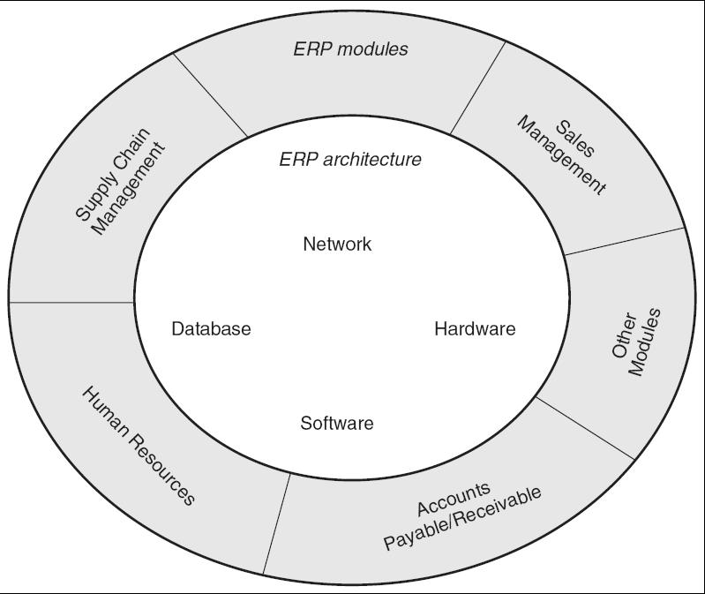
Figure 3-1 Enterprise Systems Architecture (ESA) Model

Slide 25
ERP Modules
The key role of an ERP system is to provide support for such business functions as accounting, sales, inventory control, and production.
ERP vendors, including SAP, Oracle, and Microsoft, etc. provide modules that support the major functional areas of a business.
The ERP software embeds best business practices that implement the organization’s policy and procedure via business rules.

Slide 26
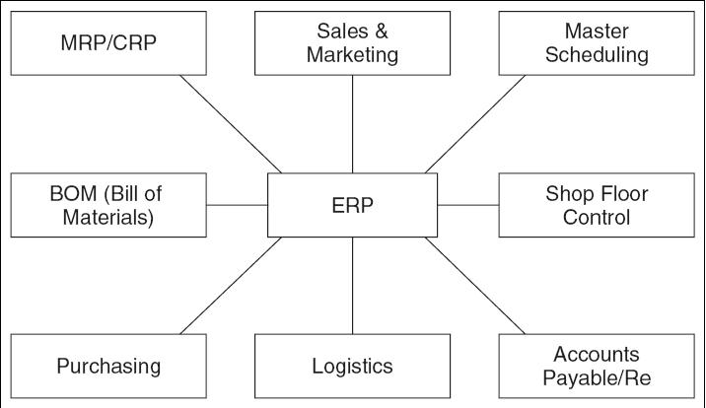
Figure 3-2 Typical ERP Modules

Slide 27
ERP Modules From Three Vendors
Function | SAP | Oracle/ PeopleSoft | Microsoft Dynamics
Sales | Sales and Distribution, Sales Opportunity | Marketing and Sales, Supply Chain Management | Retail POS, Field Service Management
Procurement | Purchasing, Supplier Relationship Management | Procurement and Supplier Relationship Management | Supply Chain Management
Production | MRP, Product Life Cycle Management | Manufacturing | Manufacturing
Accounting | Financial Accounting | Financial Management | Financial Management

Slide 28
ERP Modules From Three Vendors (Cont’d)
Function | SAP | Oracle/ PeopleSoft | Microsoft Dynamics
Distribution | Warehouse Management | Supply Chain Management | Distribution Management
Customer Service | CRM | CRM | CRM
Corporate Performance & Governance | Governance, Risk, and Compliance Management | Corporate Performance Management | Analytics
Human Resources | Human Capital Management | Human Capital Management | HR Management
Miscellaneous | Banking | Campus Solutions | E-commerce, Portals

Slide 29
Overview of Modules
Production
  Helps in the planning and optimizing of the manufacturing capacity, parts, components, and material resources using historical production data and sales forecasting.
Purchasing
  Streamlines the procurement process of required raw materials and other supplies.
Inventory Management
  Facilitates the processes of maintaining the appropriate level of stock in a warehouse.

Slide 30
Overview of Modules (Cont’d)
Sales and Marketing
  Implements functions of order placement, order scheduling, shipping, and invoicing.
Finance
  Can gather financial data from various functional departments and generate valuable financial reports.
Human Resource
  Streamlines the management of human resources and human capitals.
Miscellaneous Modules
  Nontraditional modules such as business intelligence, self-service, project management, and e-commerce.

Slide 31
Benefits of Key ERP Modules
Self Services
  Flexible support for employees’ business functions.
  Simplified access to relevant information.
Performance Management
  Delivery of real-time, personalized measurements and metrics.
  Provides executives with access to such information as business statistics and key performance measurements.
Financials
  Ensure compliance and predictability of business performance.
  Gain deeper financial insight and control across the enterprise.
  Automate accounting and financial SCM.
  Rigorous support for financial reporting—SOX Act.

Slide 32
Benefits of Key ERP Modules (Cont’d)
HR Management
  Attract the right people, develop and leverage talents, align efforts with corporate objectives, and retain top performers.
  Increase efficiency and help ensure compliance with changing global and local regulations by using standardized and automated workforce processes.
  Enable creation of project teams based on skills and availability, monitor progress on projects, track time, and analyze results.
  Manage human capital investments by analyzing business outcomes, workforce trends and demographics, and workforce planning.

Slide 33
Benefits of Key ERP Modules (Cont’d)
Procurement and Logistics Execution
  Sustain cost savings for all spending categories by automating such routine tasks as converting requisitions into purchase orders and by allowing employees to use electronic catalogs to order products and services.
  Reduce costs through process automation, integration of suppliers, and better collaboration.
  Improve resource utilization with support for cross-docking processes and data collection technologies. (RFID and bar codes).
  Enhance productivity of incoming and outgoing physical goods movements.
  Reduce transportation costs through better consolidation and collaboration.

Slide 34
Benefits of Key ERP Modules (Cont’d)
Product Development and Production
  Shorten time to market.
  Deliver higher quality products and ensure timely delivery.
  Real time visibility and transparency (availability check).
Sales and Service
  Higher number of sales orders processed and reduction in administrative costs.
  Easy access to accurate, timely customer information.
  Cost-effective mobile access for field employees.
  Reduce travel costs by using online functions.
  Adhere to environmental, health, and safety reporting requirements.
  Improve the management of incentives and commissions.
  Realize more effective real estate management.

Slide 35
ERP Architecture
ERP system architecture is organized in layers or tiers to manage system complexity in order to provide scalability and flexibility.
Three-layer architecture (the most reliable, flexible, and scalable architecture) is the most prevalent today and includes:
  Web Servers.
  Application Servers.
  Database Servers.

Slide 36
Layered Architecture Example (Info.Net)
The Layered ERP architecture generalizes the functional layers to allow it to change with newer technologies.
A Web-based user interface is provided.
  Users can access the application via the Internet.
  The PC needs to be capable of running a Java-enabled Web browser.
  The PC is connected to both Intranet and Internet to be able to use one of Info.Net’s servers.
  The user interacts with the Java Virtual Machine™ Interface layer to establish a secure connection via a secure socket layer (SSL) connection.
  The user is then communicating with the server through the applications software layer (ASL).

Slide 37
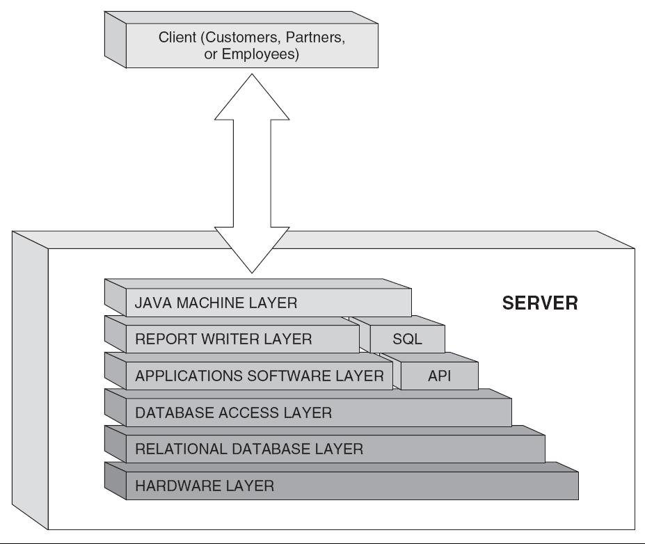
Figure 3-3 Example of Info.Net Architecture

Slide 38
Infrastructure Requirements
Traditional networks require upgrading prior to the deployment of ERP systems and must be a component of the overall budget.
A high-availability network is a requirement for a fully functioning ERP system, one that grows with the user population and supports continued expansion and integration of a supply chain.
Integration with partner and customer systems allows “a company to manage important parts of the business such as order tracking, inventory management etc.”
Online analytical processing (OLAP) provides the ability to access, present, and analyze data across dimensions.

Slide 39
Three-Tier Architecture
Most of the current ERP implementations follow a three-tiered architecture, which consists of a Web tier, an application tier, and a data tier.
Benefits
  Scalability - Easier to add, change, and remove applications.
  Reliability - Implementing multiple levels of redundancy.
  Flexibility - Flexibility in partitioning is very simple.
  Maintainability - Support and maintenance costs are less on one server.
  Reusability - Easier to implement reusable components.
  Security - IT staff has more control system to provide higher security.
Limitations
  Can be very expensive and complex.

Slide 40
Tiers
The Web Tier
  Web-based portal allows users the ability to access and analyze information through their Web browser.
The Application Tier
  Consists of a Web browser and reporting tool where business processes and end-users interact with the system.
  It shields the business users from the inner workings of an ERP system, but still provides the information relevant to their job and business process.
The Data Tier
  Focus is on structure of all organizational data and its relationships with both internal and external systems.

Slide 41
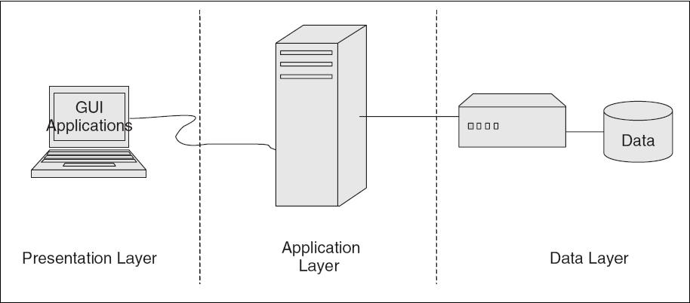
Figure 3-4 A Three-Tier ERP Architecture

Slide 42
Web Services Architectures
Web-based architecture often described as a fourth tier where the Web tier is split into Web Services tier and Web Browser tier.
The ERP systems focus on the Internet to provide a powerful new functionality for Internet-based access and integration.
This functionality is primarily supported through the following Internet access technologies:
  Web Server.
  ERP Portal.
  Back-end Server Integration.
  Browse Plug-ins or Applets.

Slide 43
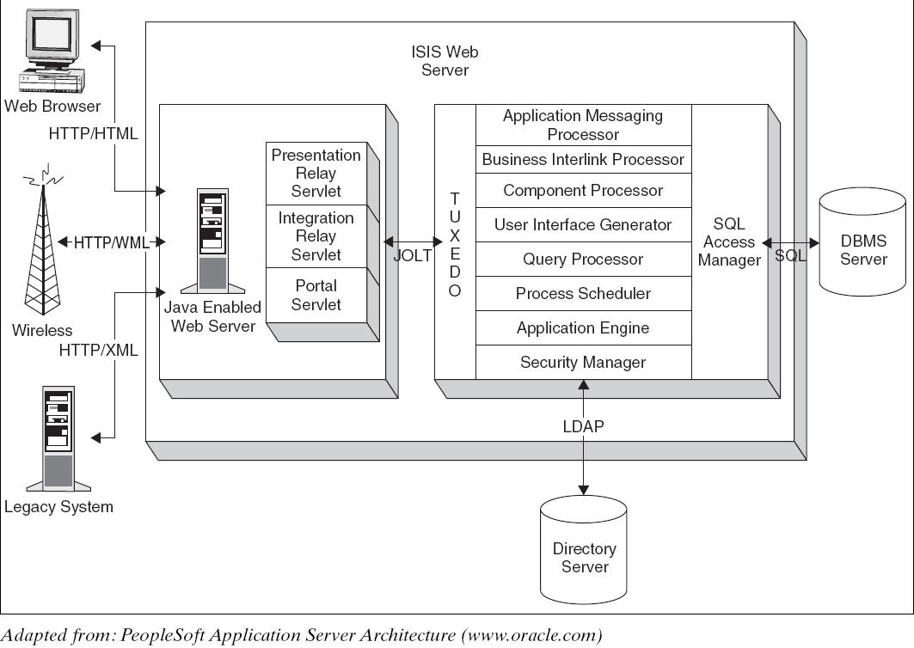
Figure 3`-5 Example of PeopleSoft’s Server-Centric Internet Architecture

Slide 44
Benefits and Drawbacks
Benefits
  Large numbers of end-users have access to ERP applications over the Web.
  Easily integrate ERP applications with existing systems.
  Server-centric—No complex, expensive client software installation.
  The server-centric architecture enables secure end-user access to ERP application.
  Client-centric—Architecture has better response time because user requests are mostly processed on the client’s computer.
  Web-based architectures also allow better system-to-system integration.
Drawbacks
  Client-centric architectures lack security.
  Server centric is slower.

Slide 45
Service-Oriented Architectures
Also known as object-oriented architectures for Web platforms.
Breaks the business tier into smaller, distinct units of services, collectively supporting an ERP functional module.
Allows message interaction between any service consumer and service provider.
A consumer from a device using any operating system in any language can use this service.

Slide 46
Service-Oriented Architectures
SOA is a software development model based on a contract between a consumer (client) and a provider (server) that specifies the following:
  Functional description of the service.
  Input requirements and output specifications.
  Precondition environment state before service can be invoked.
  Post condition environment state after service has been executed.
  Error handling when there is a breakdown.

Slide 47
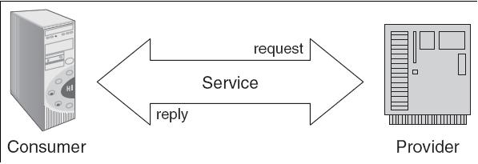
Figure 3-6 A SOA Architecture

Slide 48
Benefits of Service-Oriented Architectures
Business-level software services across heterogeneous platforms.
Complete location independence of business logic.
Services can exist anywhere (any system, any network).
Loose coupling across application services.
Granular authentication and authorization support.
Dynamic search and connectivity to other services.
Enhances reliability of the architecture.
Reduces hardware acquisition costs.

Slide 49
Benefits of Service-Oriented Architectures (Cont’d)
Accelerates movement to standards-based server and application consolidation.
Provides a data bridge between incompatible technologies.
Provides the ability to build composite applications.
Creates a self-healing infrastructure that reduces management costs.
Provides truly real-time decision-making applications.
Enables the compilation of a unified taxonomy of information across an enterprise.

Slide 50
Business Value Benefits of SOA
Increases the ability to meet customer demands more quickly.
Lower costs associated with the acquisition and maintenance of technology.
Empowers the management of business functionality closer to the business units.
Leverages existing investments in technology.
Reduces reliance on expensive custom development.

Slide 51
Drawbacks of Service-Oriented Architectures
SOA implementations are costly and time-consuming.
Requires complex security firewalls in place to support communication between services.
Performance can be inconsistent.
Requires enterprise-level focus for implementation to be successful.
Security system needs to be sophisticated.
Costs can be high because services needs to be junked very often.

Slide 52
SOA and Web Services
Web services basically are interfaces that allow different software application and components to be operated together.
According to IT industry standards, different applications can interact with without communication problems.
The only method of interaction by Web services is by receiving and sending messages.
Services are developed using open standards such as WSDL (Web Services Description Language), UDDI (Universal Description, Discovery, and Integration), and SOAP (Simple Object Access Protocol).
The protocols used in Web services are XML-based.

Slide 53
Enterprise Content Management and SOA
Enterprise content management deals with enterprise software products that usually store, preserve, manage, and deliver content connected to business processes.
Enterprise content management also about supporting business goals, not just managing content.
Vendors have come to an understanding that content management takes advantage of technology and information assets across the business and is no longer application specific.

Slide 54
Cloud Architecture
Cloud computing is basically a software service provided over the Internet, securely, by a service provider on a monthly or yearly lease.
Companies leasing CC services save money by replacing their purchased software that requires a license fee per seat.
Some cloud computing providers also let you build your own applications using their engines and then they would host those applications for you as part of the service.

Slide 55
Cloud Architecture
The cloud computing platform provides a great alternative for organizations that do not want to:
  Purchase, install, or maintain software applications.
  Worry about security, privacy and legal issues associated with data storage.
The cloud computing platform is risky for organizations as it forces them to rely on external vendors for reliability, security, and continuity of enterprise applications.

Slide 56
Benefits of Cloud Computing
Pay for subscription, not for licenses and upgrades.
Reduced capital and operating expenditures for IT equipment and support personnel.
Accessed from everywhere, as long as you have an Internet connection.
No need to install anything on the user’s computer.
Dynamic scalability available on demand.
No maintenance fees for software or hardware.
Promotes green computing environment as servers in cloud run on clean energy.
Guaranteed reliability.

Slide 57
Drawbacks of Cloud Computing
Data security.
Vulnerability.
Possible conflict of interest, if the company who stores your applications decides to create a similar application to what you created on their servers.
Not suited for all highly competitive industries like biotech where intellectual property cannot be protected easily.

Slide 58
Implications for Management
Enterprise architecture is an important technology for the long-term functioning of the organization.
ERP architecture decisions are complex because their impact goes beyond systems and technology to people, organizational policy, and business processes.
ERP architecture must be flexible to support a diverse set of hardware and software platforms.
Management must learn how to filter out the hyped technologies that do not provide value to their organization.

